Slide 1

1.2A Data Curation & Management
Introduction to Data Management Concepts and Practices
Helen R. Tibbo
tibbo@email.unc.edu
September 7, 2016

Slide 2
Goals for This Session
Understand the general scope of digital and data curation as areas of professional activity;
Become familiar with many of the concepts, principles, tools, practices, and terminology that are central to data curation and management.

Slide 3
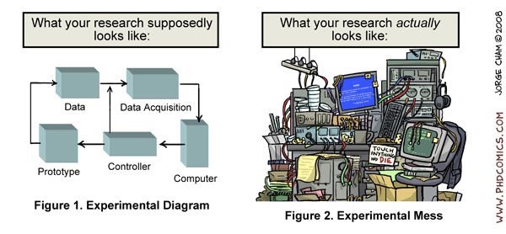
Why Do We Need Data Curators?

Slide 4
How We Often Treat Data
Video from NYU Health Sciences Library:
https://www.youtube.com/watch?v=N2zK3sAtr-4

Slide 5
Fourth Paradigm Science and Data Curation

Slide 6
A Fourth Type of Science/Research
For thousands of years – Experimental Science
Description of natural phenomena
For a few hundred years – Theoretical Science
Newton’s Laws; Maxwell’s Equations…
For a few decades – Computational Science
Simulation of complex phenomena
Today – Data-Intensive Science/Research
Scientists need to deal with an overwhelming number of disparate data sets captured by instruments, sensors, and simulations
E-science is a set of tools and techniques to support data federation and collaboration

Slide 7
The Fourth Paradigm Affects All of Us
“Data is at the heart of this new paradigm, and it sits alongside empiricism, theory, and simulation, which together form the continuum we think of as the modern scientific method”(Hey, Tansley & Tolle, 2009, 210)
“The techniques and technologies for such data-intensive science are so different that it is worth distinguishing data-intensive science from computational science as a new, fourth paradigm for scientific exploration”(Hey, Tansley & Tolle, 2009, xix)
Growth of “data science” that can be applied to a wide range of endeavors.
We have little experience with this and there is much to learn – many pitfalls.
Notes:
“Data-intensive science…will mean more paradigm shifts of scientific theory, happening faster, because we can rapidly assess our worldview against the ‘objective reality’ we can so powerfully measure”(Hey, Tansley & Tolle, 2009, 210)
Gestation of two branches in each discipline: e.g. ecology: 1) computational ecology (simulation); 2) eco-informatics (collecting and analyzing data)

Slide 8
Data Curation and Intelligence
The intelligence gathering you do has also become more data-intensive.
Data Curation is key to data quality and thus key to high-quality data-intensive science, government, intelligence, and commerce.
Data curation programs oversee and provide care for data, regardless of source or content, to ensure that data remains authentic, reliable, and complete.
Data curation preserves provenance, context, and metadata along with the target data.

Slide 9
Cyberinfrastructure
How does data curation fit in with other data and computing buzz phrases such as cyberinfrastructure?
In 2005, NSF’s Cyberinfrastructure Council issued a key report. They note that cyberinfrastructure
“integrates hardware for computing, data and networks, digitally-enabled sensors, observatories and experimental facilities, and an interoperable suite of software and middleware services and tools”(NSF Cyberinfrastructure Council, 2005, 4)
Convergence: networking; software; visualization; data systems; collaboration platforms
“Sophisticated software, visualization tools, middleware and scientific applications created and used by interdisciplinary teams are critical to turning flops, bytes and bits into scientific breakthroughs”(NSF Cyberinfrastructure Council, 2005, 4)

Slide 10
Cyberinfrastructure
Atkins Report (2003):
“a new age has dawned in scientific and engineering research, pushed by continuing progress in computing, information, and communication technology, and pulled by the expanding complexity, scope, and scale of today’s challenges”(1)
“emerging vision”: “use cyberinfrastructure to build more ubiquitous, comprehensive digital environments that become interactive and functionally complete for research communities in terms of people, data, information, tools, and instruments and that operate at unprecedented levels of computational, storage, and data transfer capacity”(2)

Slide 11
Challenges for Cyberinfrastructure
Synergize efforts of computer science and information science and their uses in science and engineering research and education;
Capture cyberinfrastructure’s commonalities across science and engineering disciplines;
Use cyberinfrastructure to enable collaborate across science and engineering disciplines;
Exploit technology being developed commercially; also feed back new approaches from sciences into larger world;
Engage social scientists in these efforts.
Federate data.
Curate the data!

Slide 12
Data Curation & Cyberinfrastructure
Notions of cyberinfrastructure and data curation developed about the same time in the early 2000’s.
Cyberinfrastructure focuses on building systems and networks and other tools upon which you can send and compute on data.
Cyberinfrastructure received the most attention and funding first and still. (We like to build stuff and we need these data highways and tools in order to work on data.)
Little funding put into ensuring the quality and reliability of data. That is what we are talking about today.
We need both cyberinfrastructure and data curation.

Slide 13
Obstacles to 4th Paradigm Science and Data-Intensive Research
“terrible” (and idiosyncratic) data management tools for most science disciplines;
scientists’ prosaic data analysis is “truly dreadful”(Hey, Tansley & Tolle, xxiv)
Hey, T., Tansley, S. and Tolle, K. (Eds.). The Fourth Paradigm: Data-Intensive Scientific Discovery. Redmond, WA: Microsoft, 2009. http://research.microsoft.com/en-us/collaboration/fourthparadigm/.

Slide 14
Obstacles to 4th Paradigm Business, Medicine, Government, Etc…
“terrible” (and idiosyncratic) data management.

Slide 15
Exercise 1
Please break into groups and introduce yourselves to each other and discuss a bit about what you do. Look for commonalities, differences, and points of congruence.
Discuss what you see in your work situations as the greatest barriers to data curation.

Slide 16
Brief Definitions
Digital Curation
Digital Archiving
Digital Preservation
Data
Big Data
Good Data
Database
Data Curation
Authenticity

Slide 17
OSE Data Management Terms
Data – Noun. The representation of facts, concepts, or instructions in a formalized manner that can be used for communication, interpretation, or processing by humans or by automatic means. Any representations such as characters or analog quantities to which meaning is or might be assigned. (Adapted with minor change from DOD JP 1-02 definition)
Data collector – Noun. Synonymous with “data owner”. The entity that acquired the data resource under specific legal and regulatory authorities
Data curator – Noun. Entity that maintains relationships with collectors, providers, stewards, Information Management Technical Officers and Collection Management Officers to ensure that enterprise data holdings are appropriately documented and tracked in the our data management platform.

Slide 18
OSE Data Management Terms
Data steward – Noun. A data steward is the recognized subject matter expert designed as accountable for the effective control and use of data assets.
Data owner – Noun. Synonymous with “data collector”. The entity that acquired the data resource under specific legal and regulator authorities
Data scientist – Noun. Role and career service dedicated to applying expertise in mathematics, statistics and computer science to more fully utilize the intelligence data we collect, improve our business processes, and better inform internal and external decision makers.

Slide 19
What Is Digital Curation?
First - what it is not:
Not Records Management
Not a software system like a digital repository
Not a Digital Library
Not just Digital Archiving, but it involves this
Not just Digital Preservation, but it involves this
It is:
Life Cycle creation and maintenance of durable digital content
An emerging profession in libraries, archives, and anywhere there is digital data and content

Slide 20
What Is Digital Curation?
Digital curation involves maintaining, preserving and adding value to digital research data throughout its lifecycle.
The active management of research data reduces threats to their long-term research value and mitigates the risk of digital obsolescence. Meanwhile, curated data in trusted digital repositories may be shared among the wider … research community.
As well as reducing duplication of effort in research data creation, curation enhances the long-term value of existing data by making it available for further high quality research.
- See more at: http://www.dcc.ac.uk/digital-curation/what-digital-curation#sthash.muJvwHoc.dpuf

Slide 21
Key Points of the Definitions
Preserved for future use – future users must be able to open, perform, and understand preserved data.
Entails the data lifecycle; from standards setting (as in file formats) and data creation through active storage, archiving, reuse, and ultimate disposition of data.
Preservation over time.
Active management – not just keeping paper in boxes or bits in storage; digital curation requires ongoing effort (and cost).
Not just “digital archiving” or “digital preservation”
Much of the digital curation workflow involves working with data creators and data users; technology is just a small part.

Slide 22
Digital Curation, Archiving, & Preservation
Curation: The activity of managing and promoting the use of data from its point of creation, to ensure it is fit for contemporary purpose, and available for discovery and re-use. For dynamic datasets this may mean continuous enrichment or updating to keep it fit for purpose. Higher levels of curation will also involve maintaining links with annotation and other published materials.
Archiving: A curation activity, which ensures that data is properly selected, stored, can be accessed and that its logical and physical integrity is maintained over time, including security and authenticity.
Preservation: An activity within archiving in which specific items of data are maintained over time so that they can still be accessed and understood through changes in technology (Lord et al., 2004, p. 1).

Slide 23
Streams of Activity Related to Digital Curation (from Dr. Christopher Lee)
Care & properties of physical media
Digital forensics & data recovery
Hardware & software interoperability
Institutional & manuscripts archives
Social science data archives
Physical science data archives
Librarianship (esp. digital libraries)
Art & museum curation
Medical information (e.g. imaging, informatics, health records)
Lawyers & auditors
Computer-supported cooperative work (CSCW)
Management of information systems (MIS)
Research on documents & document-centric computing
Standards development

Slide 24
What Are Data?
Simple Definitions:
Acts or information used usually to calculate, analyze, or plan something
Information that is produced or stored by a computer
Fuller Definitions:
factual information (as measurements or statistics) used as a basis for reasoning, discussion, or calculation
information output by a sensing device or organ that includes both useful and irrelevant or redundant information and must be processed to be meaningful
information in numerical form that can be digitally transmitted or processed
- http://www.merriam-webster.com/dictionary/data

Slide 25
What Are Data?
“any information in binary digital form.” (DCC, 2008)
“A reinterpretable representation of information in a formalized manner suitable for communication, interpretation, or processing. Examples of data include a sequence of bits, a table of numbers, the characters on a page, the recording of sounds made by a person speaking, or a moon rock specimen.” Source: OAIS Reference Model, 2012.
- See more at: http://www.dcc.ac.uk/digital-curation/glossary#D

Slide 26
Born Digital vs. Digitized
Born Digital Materials
Originally created by a computer
Could have an analog equivalent (e.g., printed Word document) or not (e.g., database)
Digitized materials are the result of a digitization process.
Once digital, issues and curation are the same.

Slide 27
Data Collections
Research Collections:
E.g., local data generated in a lab or research project
Community Collections:
E.g., genome databases such as MGI-Mouse Genome Informatics
International; scientists contribute data from around the world
Scientists from around the world use the data in this collection
Reference Collections:
E.g., Protein Data Bank; information about experimentally-determined structures of proteins

Slide 28
Data Variety
For example:
Observational
Simulations
Multimedia
Surveys
Performances
Computational
Software
Visualizations
Web pages
Social media content

Slide 29
Data Attributes
Beautiful!
The product of much work and effort and love
Often messy!
Often large
“Secret” knowledge needed
Useless without codebook or metadata
May be simple or complex
Researchers are messy beings
Don’t have to be accurate or “correct”…

Slide 30
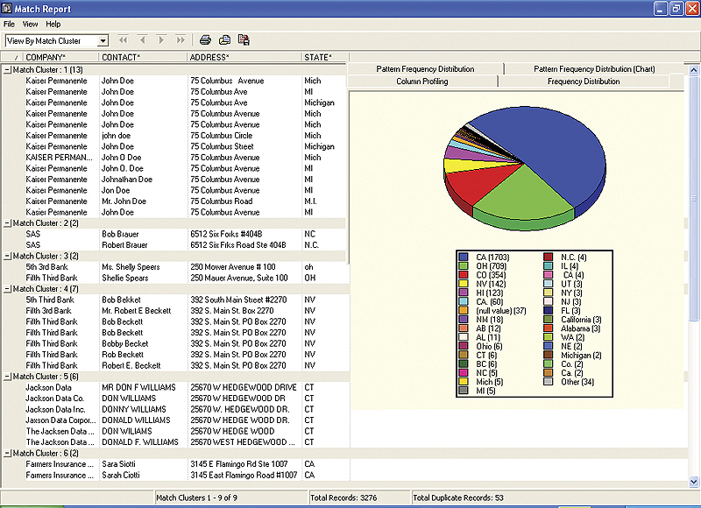
SAS Data Quality Solution. Retrieved from: http://www.sas.com/offices/latinamerica/mexico/data-quality/index.html

Slide 31
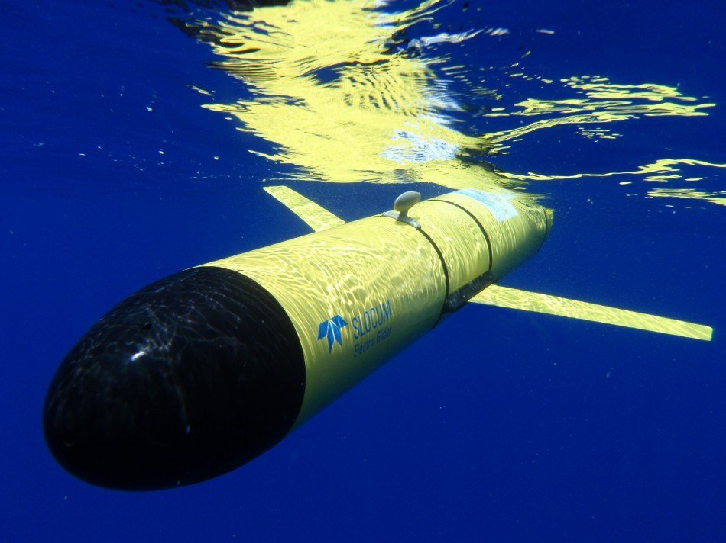
Ocean Observatories Initiative’s Glider
http://oceanobservatories.org/design/technology/robotics-auvs-gliders/

Slide 32
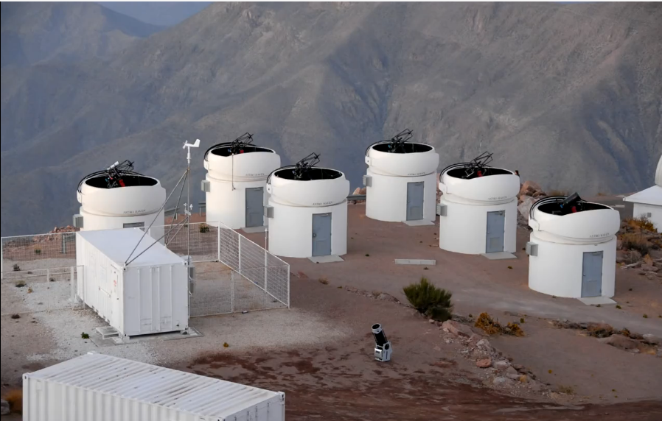
UNC Skynet Telescopes in Chile
https://www.facebook.com/photo.php?v=512493552130278

Slide 33
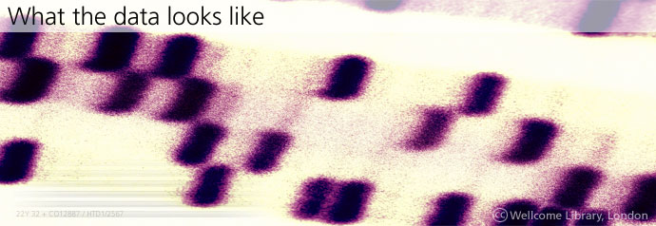
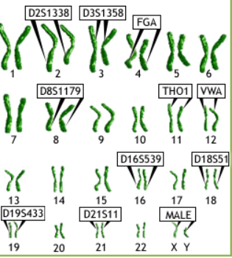
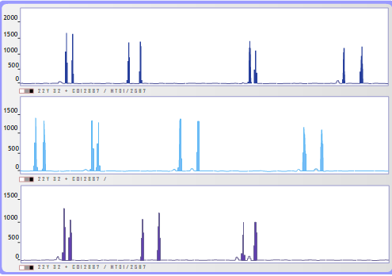
What’s This?

Slide 34
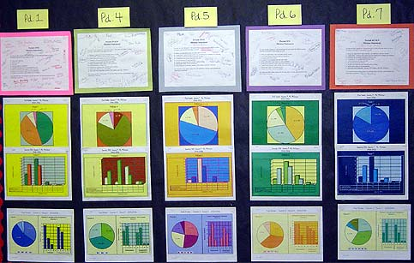
Montgomery County, MD. Public School Classroom Data Center
http://www.montgomeryschoolsmd.org/info/baldrige/staff/datacenters.shtm

Slide 35
Exercise 2
Please break into small groups and discuss data that is typical to your work.
What are the characteristics of this data?
What are the challenges it poses for analysis?
What are the risks to its longevity?

Slide 36
Big Data

Slide 37
What’s the Big Deal?
Today’s science, medicine, government, and commerce are creating massive amounts of data.
‘‘Deluge,’’ ‘‘waves,’’ and ‘‘knowledge overload’’ are some of the terms used to describe the situation (Carlson & Anderson, 2007).
New science such as genomics and those that collect data via sensors have changed data types and amounts.
4th Paradigm – data-driven science
Data grids and greater computing capacity
Massive analysis and federation of disparate datasets.
Funders want researchers to create sound data that can be re-used, thus saving funding.

Slide 38
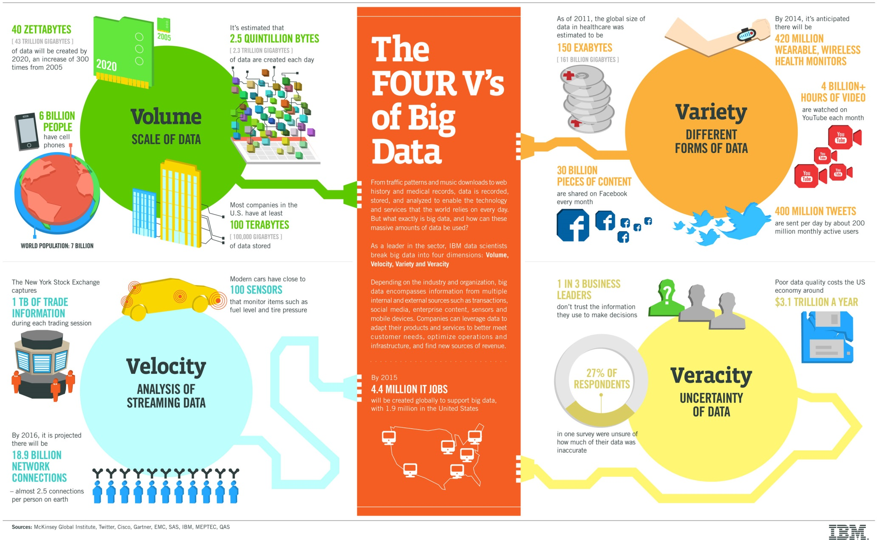
VALUE!
IBM Big Data Platform. Retrieved from: http://www-01.ibm.com/software/data/bigdata/

Slide 39
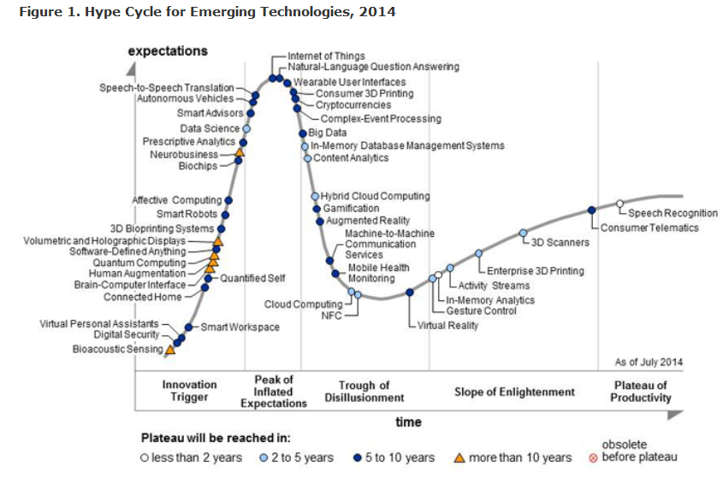
Gartner 2014 Hype Cycle
Big Data
http://www.gartner.com/newsroom/id/2819918

Slide 40
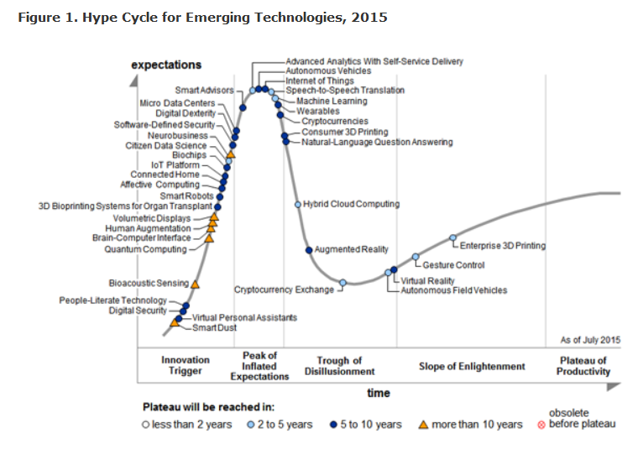
Gartner 2015 Hype Cycle
No Big Data here! Replace by Machine Learning
http://www.gartner.com/newsroom/id/3114217

Slide 41
Good Data

Slide 42
Good STEM Data
Accuracy
Validity
Reliability
Timeliness
Relevance
Completeness
Bias
Limitations
Alignment
Ownership
Colorado Stem Pipeline, 2013
http://www.coloradostateplan.com/STEM/STEMDataStrategyDraft121313-1.pdf

Slide 43
Good HIM Data
Accuracy
Accessibility
Consistency
Comprehensiveness
Currency & Timeliness
Definition
Granularity
Precision
Relevancy
http://www.carecommunications.com/blog/characteristics-data-quality/

Slide 44
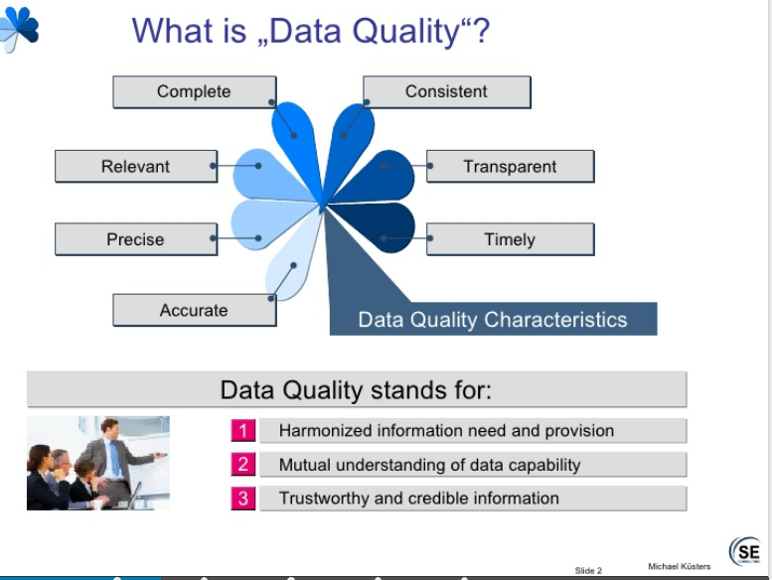
http://www.slideshare.net/MichaelKuesters/data-quality-definitions

Slide 45
Metadata
NSF definition:
Metadata “summarize data content, structure, interrelationships, and provenance.”
More generally, “data about data”.
More precisely, “structured data about data”.

Slide 46
Metadata
Metadata is structured information that describes, explains, locates, or otherwise makes it easier to retrieve, use, or manage an information resource. Metadata is often called data about data or information about information.
NISO. Understanding Metadata.” (2004) p. 1. http://www.niso.org/publications/press/UnderstandingMetadata.pdf

Slide 47
Examples of Metadata
Catalog information for books in libraries
Finding aids for archival collections
Tags on websites or other online materials
Per NSA: “It's information wireless carriers collect about where, when and to whom customers make phone calls… also, phone numbers, the time and duration of calls and the location of the caller and the recipient.”
David Golman, CNN Money. Jan. 17, 2014. http://money.cnn.com/2014/01/17/technology/security/obama-metadata-nsa

Slide 48
Life Stages of Data -1
Carlson & Anderson:
Data Collection: Born Digital and Heterogeneous Legacy Data
Much data is still collected in analog form.
Data Formatting: Codified Abstract Forms and Tacit Knowledge
“For collected materials to become data that can be used and mainly reused, they need to be rendered disseminative, that is to be rendered at the same time transportable in concise abstract forms and intelligible.”
Data must be normalized, cleaned, have adequate metadata that labels and explains the data. (pp. 307)
Carlson, Samuelle and Ben Anderson, “What are Data? The Many Kinds of Data and Their Implications for Data Re-use.” Journal of Computer-Mediated Communication, 12/2 (2007): 301-317.

Slide 49
Life Stages of Data - 2
Data Release: Ownership, Consent, and Moral Rights
IRB, ethical consideration in sharing data
Data Re-Use: Trust, Provenance, and ‘‘Cookery’’
Data re-users need to trust data creators
Methodology must be explicit and documented
“Across all case studies it was clear that this disconnection required not only visualizing data in intelligible forms, but more importantly, making explicit their context of production and setting up appropriate systems of quality checks and assessment. “ - Carlson & Anderson, p. 309-310.
Best practices help to instill trust
Research CONTEXT must be captured and articulated to users.

Slide 50
Sharing Data Is an Unnatural Act
Carlson & Anderson concluded that “two key assumptions that appear to underpin a number of discourses on e-science are not supported in practice”:
That knowledge can easily and straightforwardly be disembedded from its producers and original contexts to become explicit data for temporally and geographically distributed re-users.
That there is a binary divide between the ‘‘quantitative’’ and ‘‘qualitative’’ sciences in their approach to, and ability to benefit from, e-science tools and practices, especially in terms of data re-use.

Slide 51
What Is a Database?
“structured collections of records or data stored in a computer system.” (Ross Harvey, 2010, p.3 and http://www.dcc.ac.uk/resources/curation-lifecycle-model)
Notion of structure is important
Access through searching
Metadata is a key element
Ross Harvey, Digital Curation: A How-To-Do-It Manual (New York: Neal Schuman, 2010).

Slide 52
Authenticity
Authenticity – the quality of being authentic – allows digital assets to be reliably reused. An authentic digital resource is one that is what it purports to be, is free from corruption, and is intact in all essential respects. Authenticity should be a consideration in all digital preservation activities.
Maureen Pennock, “Digital Preservation: Continued access to authentic digital assets.” DCC Briefing Paper ( 28 November 2006). http://www.jisc.ac.uk/media/documents/publications/digital-pres-bp-v1-04-ab_web.pdf

Slide 53
Authenticity - 2
“The authenticity of a digital object refers to the degree of confidence a user can have that the object is the same as that expected based on a prior reference or that it is what it purports to be.”
“Authenticity.” PADI. Preserving Access to Digital Information. National Library of Australia. http://www.nla.gov.au/padi/topics/4.html

Slide 54
Authenticity - 3
“Underpinning authenticity and integrity and their preservation over time are the concepts of fixity, stabilisation, trust, and the requirements of custodians and users.”
- Seamus Ross, Integrity and Authenticity of Digital Cultural Heritage Objects, Digicult, p. 7.

Slide 55
Exercise 3
What steps do you/your unit take to ensure the authenticity of data that it uses?

Slide 56
Why Is Digital Curation Important?

Slide 57
Threats to Digital Continuity
Harvey sums these points up well (p. 9).
Fragility of the media content
E.g., bit rot, accidental file over writing, malicious changes and deletion
Short life of media formats
E.g., 8” disks; 5” disks; 3.5” disks; zip drives; jazz drives…
Short life of hardware and software/formats/etc.
Expense of preservation may not seem justifiable
People today need to pay for future use – hard sell
Data curation may not be anyone’s specific job
If not in a job description (let’s say, of a data creator) it won’t get done
If it is in a job description but there is little reward (or punishment as it keeps you from what is viewed as more “valuable” work ) it will not be done
Great need for data curators

Slide 58
Threats to Digital Continuity - 2
There may not be money, facilities, or trained staff to curate data.
Knowledgeable data curators (the folks whose articles we read) are just figuring data curation out (so how can we expect others to know how to do this????)
Data curation workflows are just being developed
Data curators are lobbying for funds, grants, and mandates

Slide 59
Threats to Digital Continuity - 3
Technology is a moving target
It takes a while to figure out workflows and develop tools that work with specific technologies (esp. in the open-source world)
While curation technologies are being developed to work with specific data types and technologies, the scene continuously changes
Not just preservation of static objects
Web preservation; complex data preservation, etc.

Slide 60
Threats to Digital Continuity - 4
Metadata, Metadata, Metadata
It is expensive to create – lots of person hours
Data creators do not generally want to create metadata and when they do, don’t usually use controlled vocabularies, etc.
Data curators may not understand the content well enough to create the metadata
Some automated metadata creation but a relatively small amount given the need of future re-users of data
Data without metadata is useless.

Slide 61
Threats to Digital Continuity - 5
Curators may not have legal access to data
Long-term preservation involving migration may not capture significant properties of content that would be useful to future users.
Digital data will not suffer benign neglect gladly!

Slide 62
Exercise 4
What are the benefits of digital curation for your unit/organization?

Slide 63
Challenges to Digital Curation

Slide 64
Challenges to Data Curation and Reuse
It takes work – many data creators don’t want to take on extra work after their research project is done
YouTube video assigned this week captures the attitude toward reuse perfectly.
Reuse is based on high-quality metadata that help explain the data to the next user (who did not create the data or even the data creator if he/she uses the data in the future).
Best if metadata is created at time of data creation.

Slide 65
Challenges to Data Curation and Reuse -2
Data Curation requires effort around the data lifecycle.
Lifecycle approach is essential to data curation
Need to start curation as early as possible in the lifecycle for the greatest chance of successfully providing long-term access and data reuse.
Data Curation relies on data standards and sound policies.
Like electronic records, preserved data should remain
Authentic, reliable, have integrity, and usable

Slide 66
Challenges to Data Curation and Reuse-3
It takes curation knowledge.
Most researchers (or any other data creators) have no idea how to curate their data for future use, whether it is their use or someone else’s.
There is a great need for digital/data curators as content creators don’t
Know how to curate their data well (or at all)
Have the time to curate their data (in their view at least)
Have strong enough incentives to curate their data
It is not a matter of being lazy; the cost-benefit equation is just not right for most data curators to push them to learn to curate their data.

Slide 67
Characteristics of Digital Curation
Viewing and curating data over its lifecycle is essential
E.g., helping content creators to select appropriate file formats, intermediate storage media, variable names, and metadata
It is the curator’s job to preserve the authenticity of data that will allow for reproducibility for future users.
Curator’s add value through metadata, data cleaning, preservation of significant properties, and provision of access.
There is a wide range of stakeholders.
The importance of data curation is just being recognized outside of the data curation community.

Slide 68
Characteristics of Digital Curation
Focus on authenticity and reproducibility of data
Accountability and recordkeeping
Involves adding value so digital objects can be discovered, reused, and repurposed
Many open source “solutions” are being developed
Digital curation and its tools, workflows, and techniques are evolving.

Slide 69
Information growth

Slide 70

Information Growth
Like the physical universe, the digital universe is large – by 2020 containing nearly as many digital bits as there are stars in the universe. It is doubling in size every two years, and by 2020 the digital universe – the data we create and copy annually – will reach 44 zettabytes, or 44 trillion gigabytes.
EMC Digital Universe with Research & Analysis by IDC. “The Digital Universe of Opportunities: Rich Data and the Increasing Value of the Internet of Things.” April 2014. Retrieved from: http://www.emc.com/leadership/digital-universe/2014iview/executive-summary.htm

Slide 71
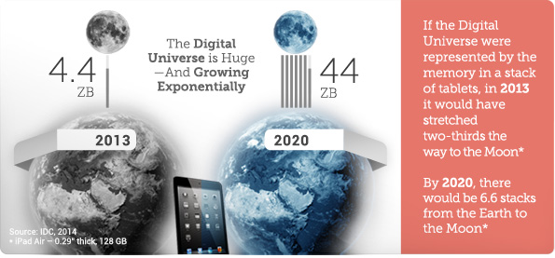
Information Growth
EMC Digital Universe with Research & Analysis by IDC. “The Digital Universe of Opportunities: Rich Data and the Increasing Value of the Internet of Things.” April 2014. Retrieved from: http://www.emc.com/leadership/digital-universe/2014iview/executive-summary.htm

Slide 72
Information Growth
In 2013, only 22% of the information in the digital universe would be a candidate for analysis, i.e., useful if it were tagged (more often than not, we know little about the data, unless it is somehow characterized or tagged – a practice that results in metadata); less than 5% of that was actually analyzed. By 2020, the useful percentage could grow to more than 35%, mostly because of the growth of data from embedded systems.
EMC Digital Universe with Research & Analysis by IDC. “The Digital Universe of Opportunities: Rich Data and the Increasing Value of the Internet of Things.” April 2014. Retrieved from: http://www.emc.com/leadership/digital-universe/2014iview/executive-summary.htm

Slide 73
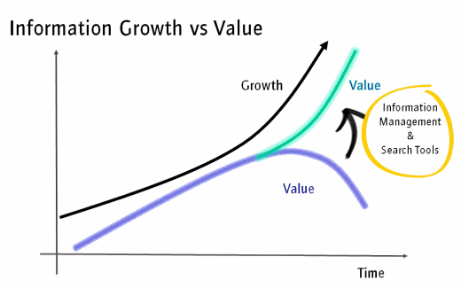
Intergen Blog. Retrieved from: http://www.intergen.co.nz/blog/steve-lapwood/dates/2010/4/lost-in-a-galaxy-of-information-unlocking-the-value-of-your-organisations-information/

Slide 74
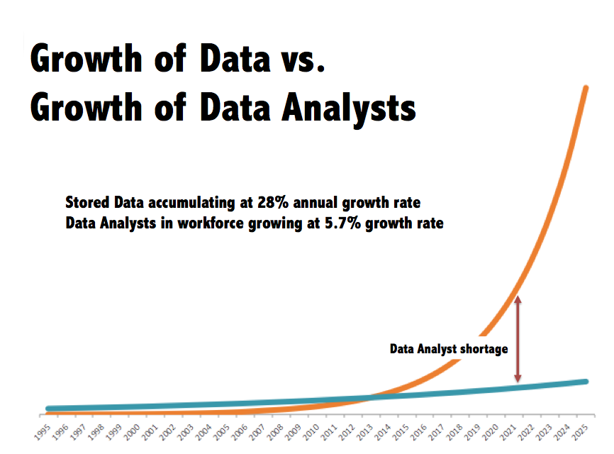
Delphi Analytics. “More Data than Analysts – the Real ‘Big-Data Problem’” Retrieved from: http://www.delphianalytics.net/more-data-than-analysts-the-real-big-data-problem/

Slide 75
I would add….
There is also a huge shortfall of data curators!

Slide 76
Implications of Data Growth for Data Curators
No escape from digital data
Digital data only has value if it is curated
Identified (tagged with metadata)
Retrievable (because of metadata)
Authentic
Renderable
Understandable (contextualized)
Interoperable

Slide 77
Implications of Data Growth for Data Curators
Data creators have less of an ability to manage their data today than in the past.
Many/most data creators do not want to manage their data any more than necessary.
There used to be secretaries and clerks
Ph.D. students often collect and manage the data
The need for data curators is growing in all sectors!

Slide 78
Summary
Viewing and curating data over its lifecycle is essential
E.g., helping content creators to select appropriate file formats, intermediate storage media, variable names, and metadata
It is the curator’s job to preserve the authenticity of data that will allow for reproducibility for future users.
Curator’s add value through metadata, data cleaning, preservation of significant properties, and provision of access.
There is a wide range of stakeholders.
The importance of data curation is just being recognized outside of the data curation community.

